Slide 1
Mocks and Stubs
Sharing by Andy Li

Slide 2
Test Case
Setup、Exercise、Verify、Tear down
System Under Test(SUT) dependency tree
Collaborator
Test Double

Slide 3
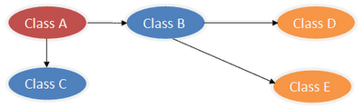
SUT dependency

Slide 4
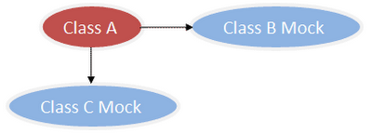
Test Double

Slide 5
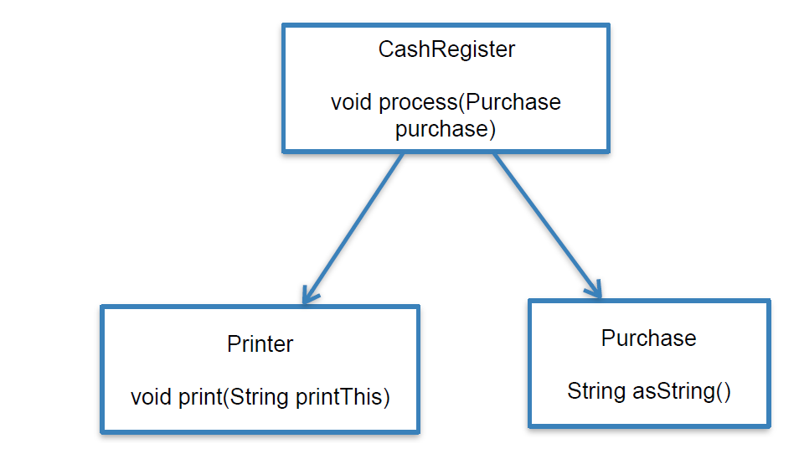
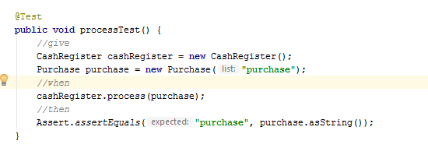
Mocks and Stubs example

Slide 6
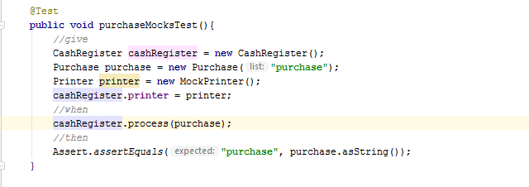
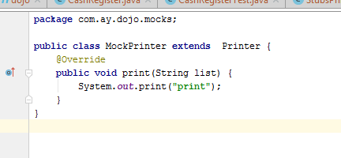
Mocks
Test manner base on verification of behavior, using mocks

Slide 7
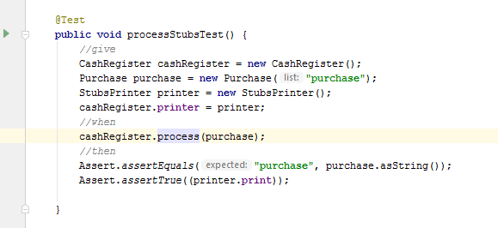
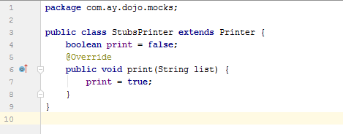
Stubs
Test manner base on verification of state, using real dependency or test double

Slide 8
Difference between Mocks and Stubs
Test Double may be used to Mocks or Stubs，difference between Mocks and Stubs is what approach will be used for verifying the test result。
Mocks use Test Double to mimicking real object
Stubs use real Dependency object or Test Double to marking state of test result。
Using Mocks or Stubs is depend on your test case。

Slide 9
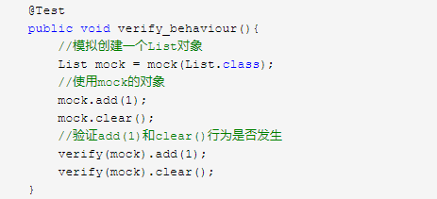
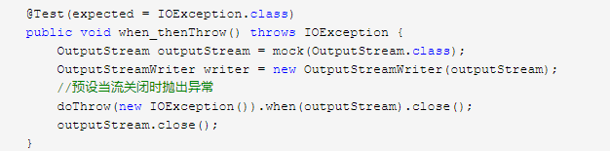
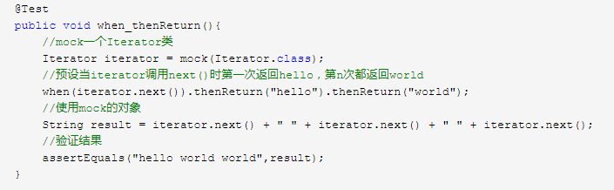
Mockito

